Slide 1

Program Evaluation Essentials
Evaluation Support 2.0
Session 3
Anita M. Baker, Ed.D. Evaluation Services
Bruner Foundation
Rochester, New York

Slide 2
Evaluation Support 2.0
Sponsored by the Bruner Foundation www.evaluativethinking.org and Evaluation Services www.evaluationservices.co
Free evaluation training and technical assistance focused on development of evaluative capacity including data analysis and reporting.
Four (4), on-site, hands-on training sessions.
Introduction to and use of free/low-cost tools to facilitate data entry, management and analysis.
Guided evaluation project required.
Virtual conference with funder, other organization participants.
Bruner Foundation
Rochester, New York

Slide 3
What do you need to do to conduct Evaluation?
Specify key evaluation questions
Specify an approach (evaluation design)
Apply evaluation logic
Collect and analyze data
Summarize and share findings
Bruner Foundation
Rochester, New York

Slide 4
What happens after data are collected?
Data are entered, managed and analyzed according to plans. Results/findings are summarized.
Findings must be converted into a format that can be shared with others.
Action steps should be developed from findings.
“Now that we know _____ we will _____.”
Bruner Foundation
Rochester, New York

Slide 5
Plan your Analysis in Advance!
  What procedures will be conducted with each set of data and who will do them?
  How will data be coded and recoded?
  How will data be disaggregated (i.e. “broken out for example by participant characteristics, or time).
  How will missing data be handled.
  What analytical strategies or calculations will be performed (e.g., frequencies, cross-tabs).
  How comparisons will be made.
  Whether/which statistical testing is needed.
Bruner Foundation
Rochester, New York
Notes:
Analytical procedures – such as frequency – the percent that experienced a certain factor or result, or comparisons among groups. Participant characteristics may include age, gender, race/ethnicity, - we will cover more detail on the ways to break down your data in this presentation when we get to the analyses in more details
For example, Danielle may have a certain target for how may or what percentage of the moms will agree to breastfeed upon delivery. If analyzing results of the # of moms breastfeeding after delivery, will want to compare it to the target of how many they were aiming for.
***I got a couple sample analysis plans from Tina that we can include as examples in the resources section. They are very complex, but I’ll work with Elena to simplify them.

Slide 6
Analyzing Quantitative Data
Important Things to Look at or Summarize
What to Do
Calculate Frequencies
Calculate Total and/or Valid Percentages
What That Means
Count how many there are of something. Count how often something (e.g., a response) occurs.
Frequency/total *100
Example Questions You Could Answer
How many participants were in each group? What were the demographics of participants? How many answered “Yes” to Question 2?
What proportion of participants met intensity targets? What proportion of all those who answered question 2, said “Yes.”
Bruner Foundation
Rochester, New York
Notes:
For example, we might say that the mean length of stay in a shelter is 11 days; yet the mode is 7 days (most common length of stay), and the median is 9 days – out of 30 cases, 15 are less than 9 days and 15 are above 9 days.
Frequencies: Of the 30 grandparents taking the survey, 20 said that the support they receive at the center helps them care for their grandchildren.
Percentages – that means that 67% (20/30*100) say that the center helps them care for their grandchildren
Ratios: 10 of the 20 women receiving prenatal counseling through the Maternity care program chose to breastfeed after delivery.
Cross-tabs: (i.e. female participants were more likely to complete the program than the male participants)
If you were trying to say whether the relatinoship holds up in the larger population or is just due to chance, then you need to move to inferential statistics and would do what is called a chi square test to see if the relationship is significant but if just using to describe the data you have – for example you have the whole program population data that you are describing – then can use a cross-tab without a significance test.

Slide 7
Analyzing Quantitative Data
Important Things to Look at or Summarize
What to Do
Determine Central Tendencies
What That Means
Calculate the average (mean), or identify the median (middle) or mode (most common value). Avg. = Sum of Values Total Number of Values Total # of hours Total # of people with hours
Example Questions You Could Answer
What is the average number of hours participants attend? What is the most common numbers of days attended in a week? (mode)
Bruner Foundation
Rochester, New York
Notes:
For example, we might say that the mean length of stay in a shelter is 11 days; yet the mode is 7 days (most common length of stay), and the median is 9 days – out of 30 cases, 15 are less than 9 days and 15 are above 9 days.
Frequencies: Of the 30 grandparents taking the survey, 20 said that the support they receive at the center helps them care for their grandchildren.
Percentages – that means that 67% (20/30*100) say that the center helps them care for their grandchildren
Ratios: 10 of the 20 women receiving prenatal counseling through the Maternity care program chose to breastfeed after delivery.
Cross-tabs: (i.e. female participants were more likely to complete the program than the male participants)
If you were trying to say whether the relatinoship holds up in the larger population or is just due to chance, then you need to move to inferential statistics and would do what is called a chi square test to see if the relationship is significant but if just using to describe the data you have – for example you have the whole program population data that you are describing – then can use a cross-tab without a significance test.

Slide 8
Analyzing Quantitative Data
Important Things to Look at or Summarize
What to do
Determine Distributions
Cross-Tabulations (pivot tables are crosstabs)
What That Means
Determine the minimum value, the maximum, and/or how the data are grouped (e.g, high, medium, or low values, quartiles, percentiles, etc.).
Relationship between 2 or more variables (also called contingency analyses, can include significance tests such as chi-square analyses)
Example Questions You Could Answer
What was the least amount of attendance for the group? What was the most? How many participants fall into low, medium, and high intensity groups?
Are there relationships between participant characteristics and outcome changes?
Bruner Foundation
Rochester, New York
Notes:
For example, we might say that the mean length of stay in a shelter is 11 days; yet the mode is 7 days (most common length of stay), and the median is 9 days – out of 30 cases, 15 are less than 9 days and 15 are above 9 days.
Frequencies: Of the 30 grandparents taking the survey, 20 said that the support they receive at the center helps them care for their grandchildren.
Percentages – that means that 67% (20/30*100) say that the center helps them care for their grandchildren
Ratios: 10 of the 20 women receiving prenatal counseling through the Maternity care program chose to breastfeed after delivery.
Cross-tabs: (i.e. female participants were more likely to complete the program than the male participants)
If you were trying to say whether the relatinoship holds up in the larger population or is just due to chance, then you need to move to inferential statistics and would do what is called a chi square test to see if the relationship is significant but if just using to describe the data you have – for example you have the whole program population data that you are describing – then can use a cross-tab without a significance test.

Slide 9
Measuring Change or Difference
Sometimes analysis focuses on change between two
(or more) points in time and/or on differences between results.
What to Do
Calculate percentage change or percentage difference
Calculate percentage point change
Conduct means testing or chi square analyses
What That Means
Difference between two NUMBERS
Difference between two PERCENTAGES
Use tests to determine if results are statistically different (means tests such as t tests or ANOVA for numbers, chi square commonly for percentages)
Example Questions You Could Answer
How much did the program grow in terms of participants or dollars used or hours spent in year 2 vs. year 1? How different was site 1 from site 2 in terms of program hours?
Which site had proportionally more students who achieved outcomes? Did the proportion of students getting the correct answer change over time?
What is the probability that observed differences are due strictly to chance?
Notes:
For example, we might say that the mean length of stay in a shelter is 11 days; yet the mode is 7 days (most common length of stay), and the median is 9 days – out of 30 cases, 15 are less than 9 days and 15 are above 9 days.
Frequencies: Of the 30 grandparents taking the survey, 20 said that the support they receive at the center helps them care for their grandchildren.
Percentages – that means that 67% (20/30*100) say that the center helps them care for their grandchildren
Ratios: 10 of the 20 women receiving prenatal counseling through the Maternity care program chose to breastfeed after delivery.
Cross-tabs: (i.e. female participants were more likely to complete the program than the male participants)
If you were trying to say whether the relatinoship holds up in the larger population or is just due to chance, then you need to move to inferential statistics and would do what is called a chi square test to see if the relationship is significant but if just using to describe the data you have – for example you have the whole program population data that you are describing – then can use a cross-tab without a significance test.

Slide 10
Analysis Plan Specifics,
You Must Decide . . .
  What procedures will be conducted with each set of data and who will do them?
  How will data be partitioned?
  What types of codes will be applied to the data?
  How will comparisons be made?
    Data to other project data (within group)
    Data to expectations
    Data to data from other sources (across groups)
  There is no single process!
Bruner Foundation
Rochester, New York

Slide 11
Steps to Take When Analyzing Qualitative Data
Segment or partition data (i.e., divide it into meaningful analytical units)
Reduce data
  Code data
  Compare data
Organize, summarize and display data
Draw conclusions, verify/validate results
Revise summaries and displays accordingly
Process is Iterative
Bruner Foundation
Rochester, New York

Slide 12
Coding Qualitative Data
A priori or deductive codes: predetermined categories based on accepted theory or program knowledge
Inductive: based on raw data (not predetermined)
Hierarchical: larger categories with subcategories in each
You can combine inductive and deductive within a hierarchical coding scheme
Bruner Foundation
Rochester, New York
Notes:
I will give an example of combining codes. May have a pre-determined code of transportation barriers when analyzing a survey that asks about access to certain services. Then I may come up with (based purely on responses), sub categories of time of day that the buses run, safety on the bus lines is questionable

Slide 13
Enumeration
A strategy for organizing, summarizing, and displaying qualitative data
Quantify frequency of codes,* or types
Use counts to define results (e.g., most responses were positive; all responses fell into 4 categories – the category most exemplified was __________).
* e.g., none, some, a lot, as a percentage
Bruner Foundation
Rochester, New York

Slide 14
Coding Strategies and Reminders
Keep a master list of codes
  Distinguish a priori and inductive codes
  Re-apply codes to all segments
Use multiple codes, but keep coding schemes as simple as possible
Test out sample entries to identify potential problems before finalizing code selections
Check for inter/intra coder reliability (consistency)
  Coding is not exact (expect differences)
  Co-occurring codes (more than one applies)
  Face-sheet codes (descriptors)
Bruner Foundation
Rochester, New York

Slide 15
General Characteristics of Effective Tables and Graphs
    The table or graph should present meaningful data.
    The data should be unambiguous.
    The table or graph should convey ideas about data efficiently.
Bruner Foundation
Rochester, New York
13

Slide 16
Thinking About Tables and Figures
    Tables are organized as a series
    of rows➔ and columns ⬇.
      The first step to constructing a table is to determine how many rows and columns you need.
    The individual boxes or “cells” of the table contain the information you wish to display.
Bruner Foundation
Rochester, New York

Slide 17
Thinking About Tables and Figures
    Tables must have a table number and title (be consistent). Where possible, use the title to describe what is really in the table.
      Table 1: Percent of Respondents Agreeing with Each Item in the Customer Satisfaction Scale.
    All rows and columns must have headings.
    It should be clear what data are displayed (n’s, %s)
    You don’t have to show everything, but a reader should be able to independently calculate what you are displaying. Clarify with footnotes if needed.
    Use lines and shading to further emphasize data.
Bruner Foundation
Rochester, New York

Slide 18

Thinking About Tables and Figures
    Figures, which include graphs/charts and pictures or any other visual display also must have a figure number and title (be consistent). Like tables, use the title to describe what is really in the figure.
      Figure 1.3 Exit Status of 2006 Domestic Violence Program Participants.
    For bar and line graphs, both the X ➔ and Y ⬆ axes must be clearly labeled.
    The legend, clarifies what is shown on the graph. You can also add individual data labels if needed.
    For any bar or line graph with multiple data groups, be sure to use contrasting colors – that are printable in black and white.
Bruner Foundation
Rochester, New York

Slide 19
Rules for Pie Charts
Avoid using pie charts
Use pie charts only for data that add up to some meaningful total
Never use three-dimensional pie charts
Avoid forcing comparisons across more than one pie chart.
Bruner Foundation
Rochester, New York

Slide 20
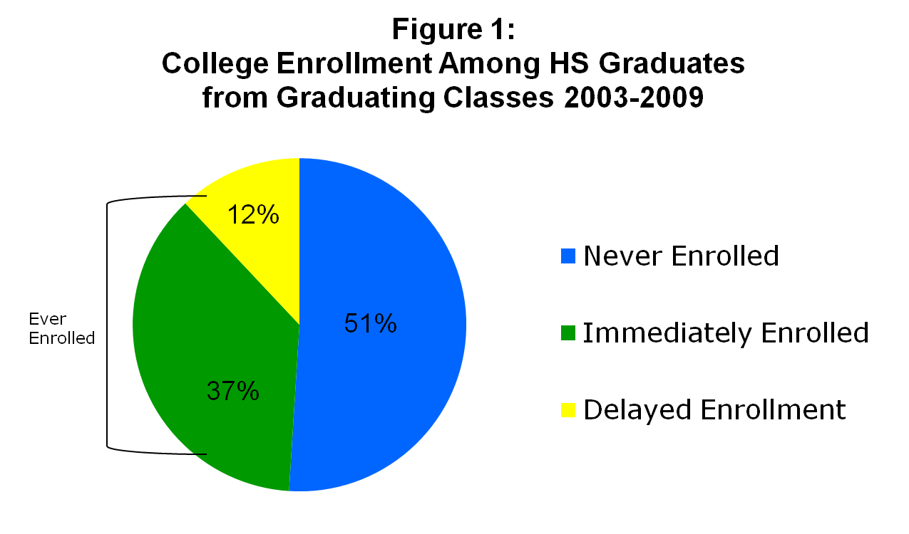
Pie Charts Show Composition of a Whole Group
Bruner Foundation
Rochester, New York

Slide 21
Rules for Bar Graphs
Minimize the ink. Do not use 3-D effects.
Sort the data on the most significant variable.
Use rotated bar charts (i.e., horizontal) if there are more than 8 – 10 categories
Place legends inside or below the plot area
Keep the gridlines faint.
With more than one data series beware of scaling distortions.
Bar charts often contain little data, a lot of ink and rarely reveal ideas that cannot be presented more simply in a table.
Bruner Foundation
Rochester, New York
19

Slide 22
Title
Figure 1: Mean Tuition & Fees, Per Semester Illinois Public Universities, 2001
Data
Label
Legend
Grid Line
$4340
Graphical Elements
$3710
Y-axis scale
$3387
X-axis label
Bruner Foundation
Rochester, New York
University
X-axis title

Slide 23
Bar Graphs Show Frequencies
Vertical or Horizontal
Percent of CSI Participants with High Attendance
(100 or more hours), by Year
Bruner Foundation
Rochester, New York
21
Notes:
22

Slide 24
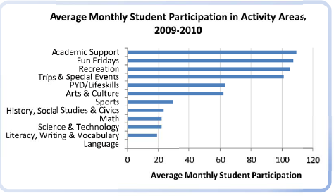
Bar Graphs Show Frequencies
Horizontal or Vertical
Bruner Foundation
Rochester, New York

Slide 25
Bars Can Be “Stacked” to Show Distribution
Use with caution especially when there is no implicit order to the categories.
Stacked bar charts work best when the primary comparisons are to be made across the data series represented at the bottom of the bar.
Bruner Foundation
Rochester, New York
23

Slide 26
Figure 3: Survey Results:
Percent of Principals Who are Satisfied with 6th Grade Literacy Achievement at Community Schools and Comparison Schools
66%
Community Schools
n=12
Comparison Schools
n=13
Bruner Foundation
Rochester, New York
24
Notes:
Howard

Slide 27
Line Graphs Show Change Over Time
Figure 6.7 Proportion of Students Passing
Proficiency Test
Bruner Foundation
Rochester, New York

Slide 28
Evaluative
Thinking

Slide 29
E-Surveys – Key Decisions
Why use an e-survey rather than a hard-copy survey/ intercept survey/ alternative survey or other data collection strategy?
What question types do you need?
  How will they be displayed?
  Do you need an “other” field?
  Should they be “required?”
Bruner Foundation
Rochester, New York

Slide 30
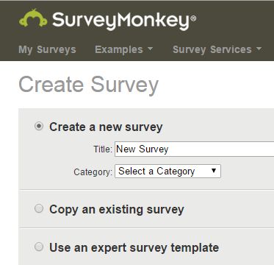
Before You Create an E-survey
Strong items
Administration plan
Analysis plan
Respondent experience

Slide 31
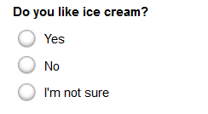
Multiple Choice (only 1 answer)
Forced Choice Item (MO)
Directions read: Mark One – unless it is so obvious that is the expectation.
Bruner Foundation
Rochester, New York

Slide 32
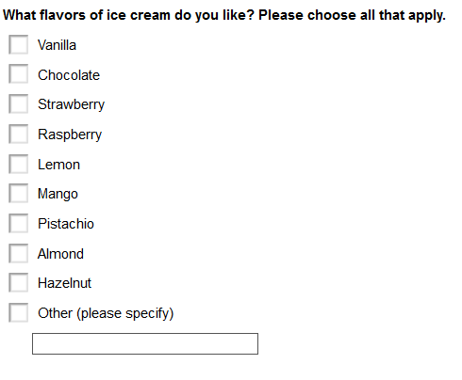
Multiple Choice (multiple answers)
Multiple Response Item (MATA)
Multiple response items often create analysis challenges. Use sparingly.
Bruner Foundation
Rochester, New York

Slide 33
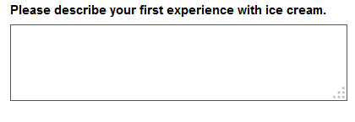
Comment/Essay Box/Open-ended
Bruner Foundation
Rochester, New York

Slide 34
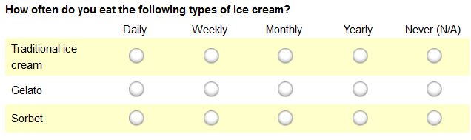
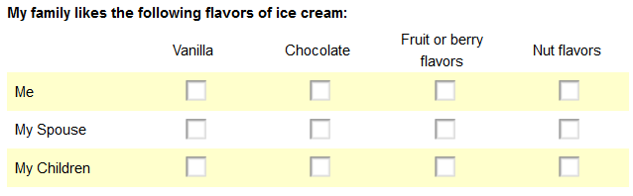
Matrix of Choices
(1 answer/row vs. multi answers/row)
Bruner Foundation
Rochester, New York

Slide 35
Likert/Rating Scale
 | Not at all important | Slightly important | Somewhat important | Moderately important | Extremely important
Quality of ingredients
Flavor
Texture
Brand
A true Likert scale has 5 answer choices, and by the way it is pronounced Lick –ert not Like –ert. (The strategy was named for Rensis Likert who invented or popularized them.)
Bruner Foundation
Rochester, New York

Slide 36

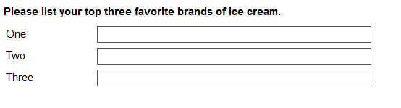
Single Vs. Multiple Textboxes
You must have an analysis plan for using these data.
Bruner Foundation
Rochester, New York

Slide 37
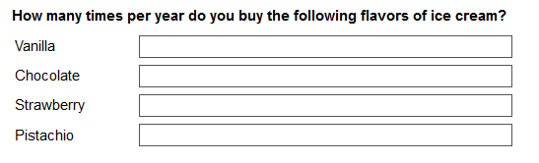
Numerical Textboxes
You must have an analysis plan for using these data. Consider hard codes (e.g., 1/month, at least 6 times per year, etc.) – and using single text boxes; or true numbers when they exist which can then be used in other calculations like averages.
Bruner Foundation
Rochester, New York

Slide 38
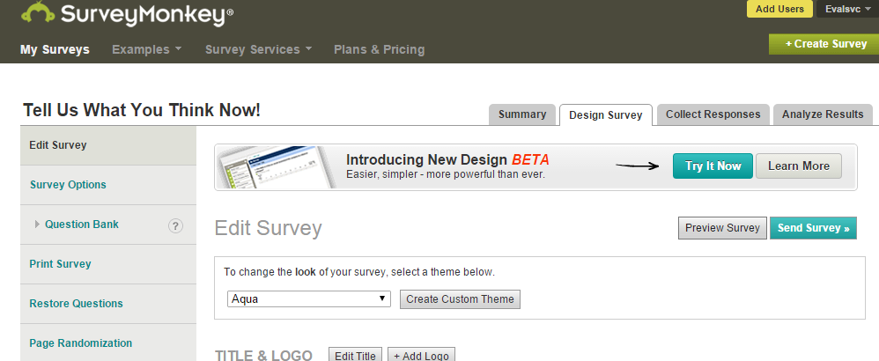
Printing a Survey
From the design survey menu select Print Survey

Slide 39
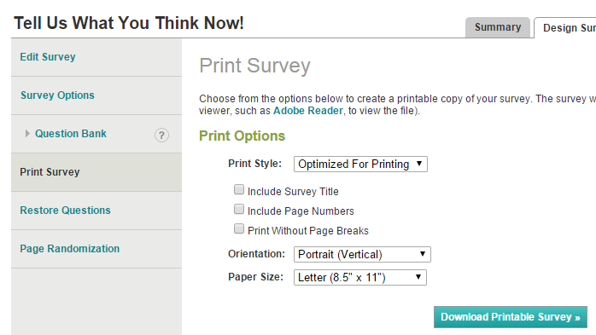
Printing Surveys
Then Click here
✓
✓
✓
This will generate a Survey in PDF format.

Slide 40
Evaluative
Thinking

Slide 41
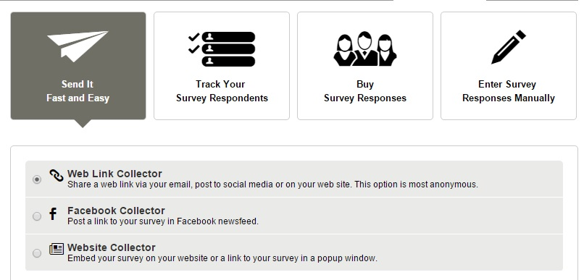
Survey Response Collector Types
  Types of collectors: Weblink; Email Tracker; Facebook/Website Post; Manual Data Entry*

Slide 42
Weblink Collector
Write your own cover email
Dear Colleague,
Recently you attended an Allied Against Violence training session provided by the Center for Anti-Violence Education and agreed to provide some follow-up feedback regarding your use of the materials and strategies. Please click on the following link to start the very brief follow-up survey. It should only take you a few minutes to respond and your answers will be kept confidential. All responses will be combined and summarized to inform CAE’s continued work in this field.
Thank you in advance for your assistance
CLICK HERE https://www.surveymonkey.com/s.aspx
Thank you pages (default or custom)

Slide 43
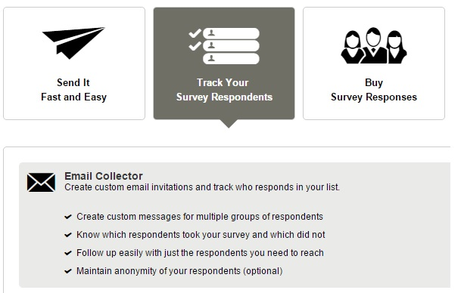
Follow-Up and Track Responses

Slide 44
Manual Data Entry: Two Strategies
  Data entry/use as a database
Weblink Collector: (Fast/Easy)
Advanced Settings:
Allow more than 1 respondent per computer
  Survey End Page: Loop to start

Slide 45
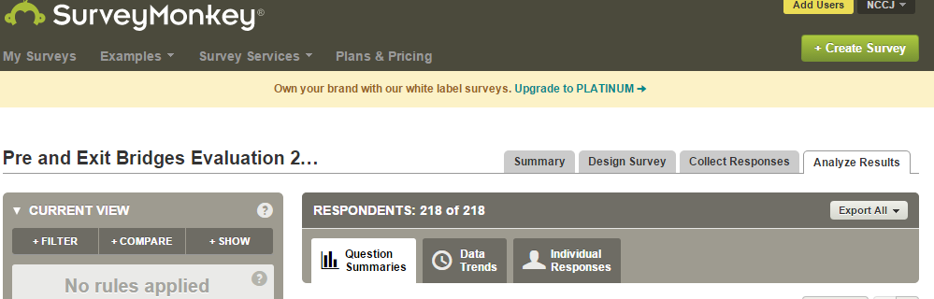
Analyzing Data Using Survey Monkey
Key Skills
Generating and using frequencies
Bruner Foundation
Rochester, New York

Slide 46
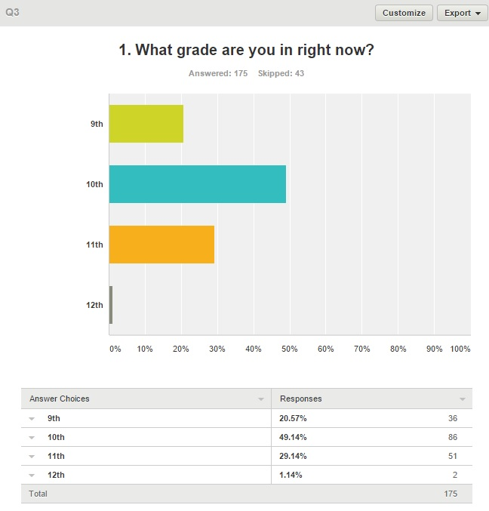
Analyzing Data Using Survey Monkey
Key Skills
Generating and customizing graphics
Exporting graphs and tables

Slide 47
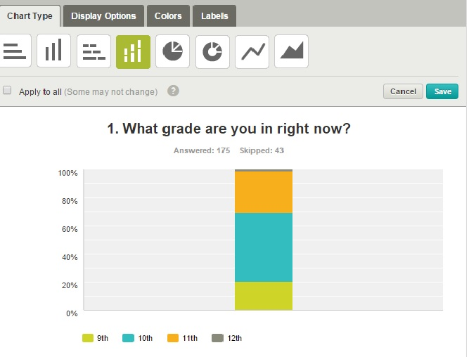

Slide 48
Analyzing Data Using Survey Monkey
Key Skills
Using Filters – allows you to select data, remove “missing data” and use numerical analysis functions.
Comparing data – calculates cross-tabs

Slide 49
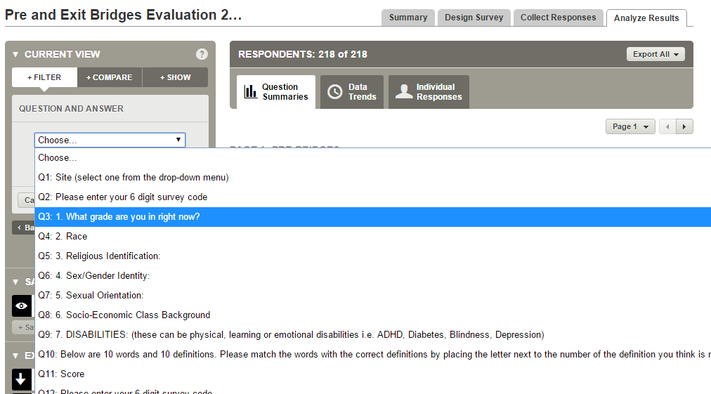
Analyzing Data Using Survey Monkey
Key Skills
Using Filters: Filter by Q&A

Slide 50
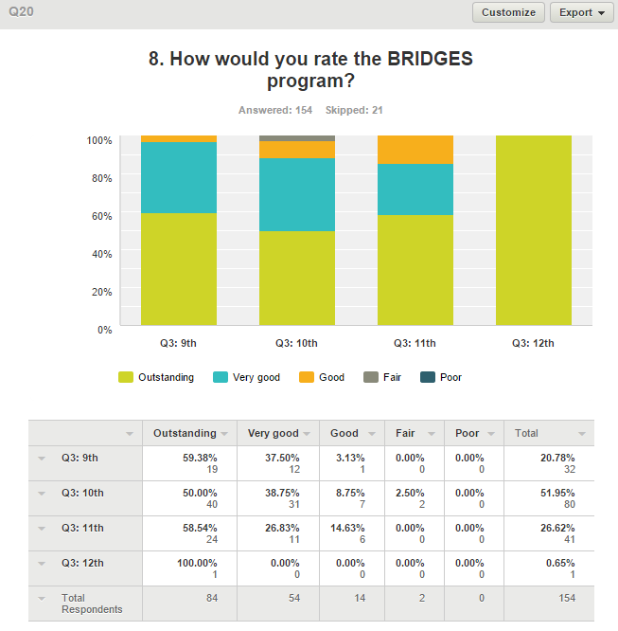
Using Compare

Slide 51
Compare/Cross-tab Considerations
Decide whether to use row or column percents to present your data. The calculations answer different questions.
  Do you want to know for each grade group how many rated the program positively (i.e., outstanding or very good)?
    OR
  Do you want to know what grade the positive respondents were in?
TIP: Pick a strategy and use it consistently.
Bruner Foundation
Rochester, New York

Slide 52
Evaluative
Thinking

Slide 53
Analyzing Data Using SM
Exporting and Merging Data
Export All - All Summary Data
(PDF – which can be customized)
Export All - All Response Data
(Excel or SPSS, Zipped File - sheet 1 has data)
Merging Data – connecting data from a survey monkey file with other data using a common key
Bruner Foundation
Rochester, New York

Slide 54
Survey Result Example: Excel Summary
BEC Session 2 - January 2012
How would you rate Session 2 overall?
Answer Options | Response Percent | Response Count
Not So Good | 0 | 0
Okay | 15% | 5
Very Good | 71% | 24
Excellent | 15% | 5
answered question |  | 34
skipped question |  | 1
Bruner Foundation
Rochester, New York

Slide 55
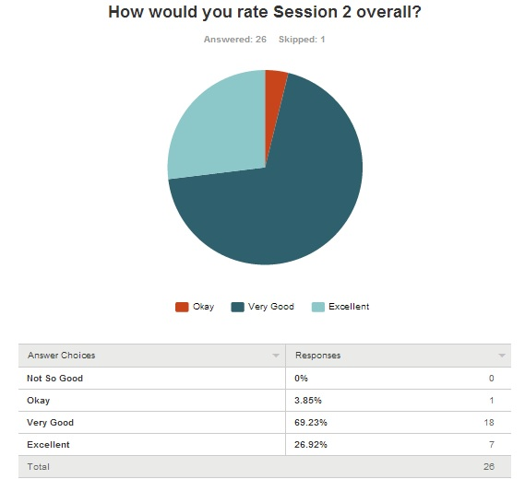
SURVEY RESULT EXAMPLE
Bruner Foundation
Rochester, New York

Slide 56
Survey Result: Crosstab Example
Disaggregated Data
% of 2011-12 Freshman who . . . | Peer Study Group |  | Total
 | Yes n=232 | No n=247 | N=479
Reported struggling to maintain grades | 36% | 58% | 47%
Are planning to enroll for the sophomore year at this school | 89% | 72% | 80%
Note: A total of 1000 Freshmen were enrolled 2011-12; 502 were in Peer Study Groups, 498 were not. About half of the students who were in study groups and half who were not responded to the survey.
Bruner Foundation
Rochester, New York

Slide 57
Definitive Statements
Percent of Training Participants (N=93) who Think AAV Helped or Will Help Them:⬇ | Some | A Lot | TOTAL
Discuss issues of violence with clients | 45% | 55% | 100%
Access additional strategies for self-care/stress reduction | 47% | 51% | 98%
Provide positive interventions for clients | 32% | 65% | 97%
Understand the importance of self-care/stress reduction | 38% | 58% | 96%
Offer clients new ways to:
De-escalate Situations | 31% | 67% | 98%
Manage Anger | 54% | 43% | 97%
Do safety planning | 45% | 52% | 97%
Conduct Bystander Interventions | 39% | 58% | 97%
Target = 50% or more say “a lot” to each
AAV met its targets for all areas of interest except Management of Anger
More than 95% of participants thought AAV helped or will help them with each of the focus areas of the training.
Bruner Foundation
Rochester, New York

Slide 58
Definitive Statements
% of 2005-06 Freshman who . . . | Peer Study Group |  | Total
 | Yes n=212 | No n=257 | N=479
Reported struggling to maintain grades | 36% | 58% | 47%
Are planning to enroll for the sophomore year at this school | 89% | 73% | 80%
Only about 1/3 of freshman in peer study groups reported struggling to
maintain their grades compared to ½ of those not in study groups.
Proportionately more study group participants are planning to enroll for sophomore year.
Bruner Foundation
Rochester, New York

Slide 59
Survey Monkey Questions?
http://help.surveymonkey.com/

